Slide 1

Big Data Analysis
Prof. Arjun Vankani
Unlocking the Power of Big Data

Slide 2
Introduction to Big Data
What is Data?
The quantities, characters, or symbols on which operations are performed by a computer,
which may be stored and transmitted in the form of electrical signals and recorded on magnetic, optical, or mechanical recording media.
What is Information? (Derived Information)
Big Data is also data but with a huge size.
Big Data is a term used to describe a collection of data that is huge in volume and yet growing exponentially with time.
In short, such data is so large and complex that none of the traditional data management tools are able to store it or process it efficiently.
“Extremely large data sets that may be analysed computationally to reveal patterns , trends and association, especially relating to human behaviour and interaction are known as Big Data.”

Slide 3

Unlocking the Power of Big Data
Big Data transforms raw information into actionable insights, enabling smarter decisions and predictive capabilities.
By harnessing advanced analytics, organizations gain a competitive edge and drive innovation across industries.
Big Data empowers organizations to understand patterns, optimize operations, and deliver personalized experiences at scale.

Slide 4
Traditional Data Vs Big Data
Feature | Traditional Data | Big Data
Data Architecture | Centralized database | Distributed database
Types of Data | Structured data | Unstructured and semi-structured data
Volume | Small (Gigabytes–Terabytes) | Very Large (Petabytes and beyond)
Data Schema | Fixed schema | Dynamic schema
Data Relationship | Easily explored; strong relationships | Relationships are harder to explore
Scaling | Vertical (scaling up with more powerful servers) | Horizontal (distributed across multiple nodes)
Accuracy | Generally less accurate with growth | Higher accuracy due to comprehensive analytics

Slide 5

Companies
Several major companies across industries handle massive volumes of Big Data, often measured in petabytes (PB) or exabytes (EB). Here are a few notable examples:
1. Google
Estimated Data Stored: Over 10+ exabytes
Use Case: Search indexing, YouTube videos, Google Maps, Gmail, Ads personalization.
Big Data Tools: Big Query, Dremel, MapReduce (original developer)

Slide 6


Companies
2. Facebook (Meta)
Estimated Data Generated Daily: ~4 petabytes/day
Use Case: Social interactions, ads targeting, image/video analysis, user behavior.
Big Data Tools: Apache Hive, Presto, Scuba, RocksDB
3. Amazon
Estimated Data Size: Unknown, but AWS handles exabyte-scale workloads.
Use Case: E-commerce analytics, customer behavior, Alexa, AWS services.
Big Data Tools: Redshift, S3, EMR, DynamoDB

Slide 7


Companies
4. Netflix
Estimated Data: ~60 petabytes+
Use Case: Content recommendations, streaming quality optimization, viewer analytics.
Big Data Tools: Apache Spark, Presto, AWS S3, Kafka
5. Walmart
Estimated Data: Over 2.5 petabytes/hour
Use Case: Inventory management, customer purchases, pricing optimization.
Big Data Tools: Hadoop, Spark, custom-built analytics engines

Slide 8

Instagram and Big Data
Estimated Data Size: Instagram stores over 100+ petabytes of data, growing daily.
Data Generated:
Over 95 million photos and videos uploaded every day
Billions of likes, comments, and interactions daily
Big Data Use Cases:
Personalized content feed (Explore, Reels)
Targeted advertisements
Spam detection and content moderation
Influencer analytics and engagement metrics

Slide 9
Data Size Units
1 Petabyte (PB) = 1,000 Terabytes = 1 million Gigabytes → Enough to store 13.3 years of HD video non-stop!
1 Exabyte (EB) = 1,000 Petabytes = 1 billion Gigabytes → Equivalent to about 250 million DVDs of data.
Unit | Size in Bytes | Real-world Example
1 Byte | 8 bits | Int data type
1 KB | 1,000 bytes | A short email without attachments
1 MB | 1,000 KB (1 million bytes) | A high-quality photo
1 GB | 1,000 MB | A full HD movie (about 1–2 hours)
1 TB | 1,000 GB | A laptop's hard drive
1 PB | 1,000 TB | All the data stored in the Library of Congress (estimated)
1 EB | 1,000 PB | Nearly all data generated globally in a day

Slide 10

Big Data File Types by Content Type
1. Text Documents
Formats: .txt, .csv, .json, .xml, .pdf, .docx
Used in: Logs, documents, emails, reports
2. Images
Formats: .jpg, .jpeg, .png, .bmp, .gif, .tiff
Used in: Social media, surveillance, facial recognition, medical imaging
3. Videos
Formats: .mp4, .avi, .mov, .mkv, .flv
Used in: Streaming services (YouTube, Netflix), security cameras, media analytics

Slide 11
Big Data File Types by Content Type
4. Audio
Formats: .mp3, .wav, .aac, .flac
Used in: Voice assistants (Siri, Alexa), podcasts, call centers, speech analytics
5. Binary Files
Formats: .exe, .bin, .dat
Used in: System-level data, sensor feeds, compiled code
6. Sensor / IoT Data
Formats: Often in custom binary or .json formats
Used in: Smart homes, wearable devices, industrial monitoring

Slide 12

Big Data Application Sectors
1. Social Media
Platforms: Facebook, Instagram, Twitter, TikTok, Snap, LinkedIn
Applications:
Personalized content feeds
Trend analysis & sentiment detection
Ad targeting & user engagement analysis

Slide 13
Big Data Application Sectors
2. E-Commerce
Platforms: Amazon, Flipkart, Alibaba
Applications:
Product recommendation engines
Dynamic pricing strategies
Inventory & supply chain optimization

Slide 14
Big Data Application Sectors
3. Banking & Finance
Organizations: HDFC, ICICI, JP Morgan, PayPal
Applications:
Fraud detection & risk management
Real-time credit scoring
Customer segmentation & personalized offers

Slide 15
Big Data Application Sectors
4. Healthcare
Use Cases:
Predictive diagnostics & patient monitoring
Genomic data analysis
Hospital resource management

Slide 16
Big Data Application Sectors
5. Transportation & Logistics
Companies: Uber, FedEx, Indian Railways
Applications:
Route optimization & traffic prediction
Real-time vehicle tracking
Demand forecasting

Slide 17
Big Data Application Sectors
6. Education
Platforms: Coursera, edX, BYJU’S
Applications:
Personalized learning paths
Dropout prediction & performance analytics
Adaptive testing

Slide 18
Evolution of data management from traditional databases to modern solutions
1. Traditional Databases (1970s–2000s)
Examples: Oracle, MySQL, PostgreSQL
Type: Structured (Rows & Columns)
Key Features:
Relational models (RDBMS)
SQL-based querying
Centralized storage
Limitations:
Poor scalability for big data
Not suited for unstructured data

Slide 19
Evolution of data management from traditional databases to modern solutions
2. Data Warehousing & BI Tools (2000s–2010s)
Examples: Teradata, SAP BW, IBM DB2, Power BI
Purpose: Historical data analysis, reporting
Enhancements:
ETL processes (Extract, Transform, Load)
OLAP (Online Analytical Processing)
Limitations:
Batch processing only
High infrastructure cost

Slide 20
Evolution of data management from traditional databases to modern solutions
3. Big Data Ecosystem (2010s–Now)
Examples: Hadoop, Spark, Hive, Kafka, NoSQL (MongoDB, Cassandra)
Key Features:
Distributed processing
Handles structured, semi-structured & unstructured data
Real-time and batch processing
Benefits:
Scalable & cost-effective
Suited for huge volumes (Petabytes+)

Slide 21
Evolution of data management from traditional databases to modern solutions
4. Cloud & AI-Driven Modern Data Platforms (Now–Future)
Examples: Google BigQuery, AWS Redshift, Azure Synapse, Databricks
Trends:
Serverless & cloud-native
Real-time dashboards & ML integration
Data lakes & lakehouses
Benefits:
On-demand scalability
Integrated with AI/ML pipelines
Lower maintenance with auto-scaling
From rigid, centralized SQL systems to flexible, cloud-based, AI-powered platforms—data management has evolved to meet the needs of Big Data, real-time analytics, and intelligent automation.

Slide 22
Structuring Big Data:
Types of Data
1. Structured Data (5-10%)
2. Semi-Structured Data (5-10%)
3. Unstructured Data ( 80-90%)
Most of today’s data is unstructured, making tools like AI, NLP, and computer vision essential for unlocking its value.

Slide 23
1. Structured Data
Format: Tabular (Rows & Columns)
Storage: Relational Databases (RDBMS)
Examples:
Customer records in SQL
Excel spreadsheets
Financial transactions
Tools: MySQL, Oracle, PostgreSQL
Easy to search, store, and analyze using SQL

Slide 24
2. Semi-Structured Data
Format: Not in strict rows/columns but has tags or markers
Storage: NoSQL databases, Data lakes
Examples:
JSON, XML, YAML
Email metadata (To, From, Date)
Sensor data from IoT devices
Tools: MongoDB, Apache Hive, Elasticsearch
Flexible format, supports complex and nested structures

Slide 25
3. Unstructured Data
Format: No predefined structure
Storage: Data lakes, distributed file systems
Examples:
Images, videos, audio files
Social media posts, PDFs
Surveillance footage, chat logs
Tools: Hadoop, Spark, Amazon S3
Requires advanced tools (AI/ML) for analysis and processing

Slide 26
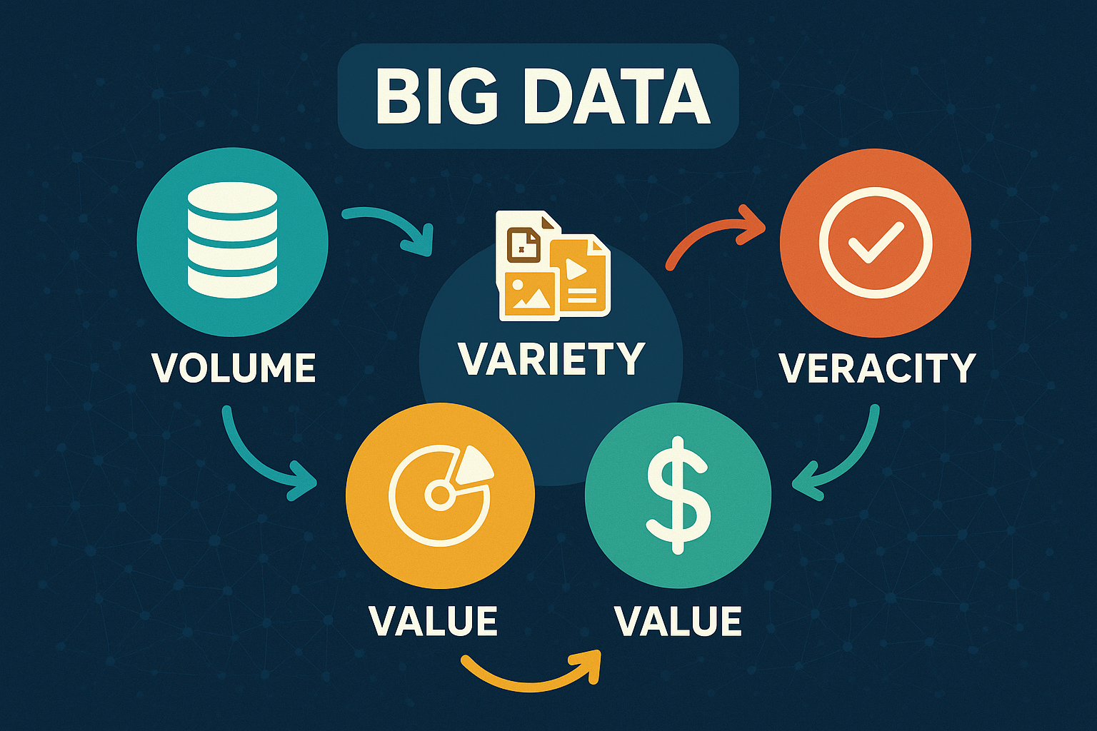
Big Data Characteristics
1) Volume
2) Variety
3) Veracity
4) Value
5) Velocity

Slide 27
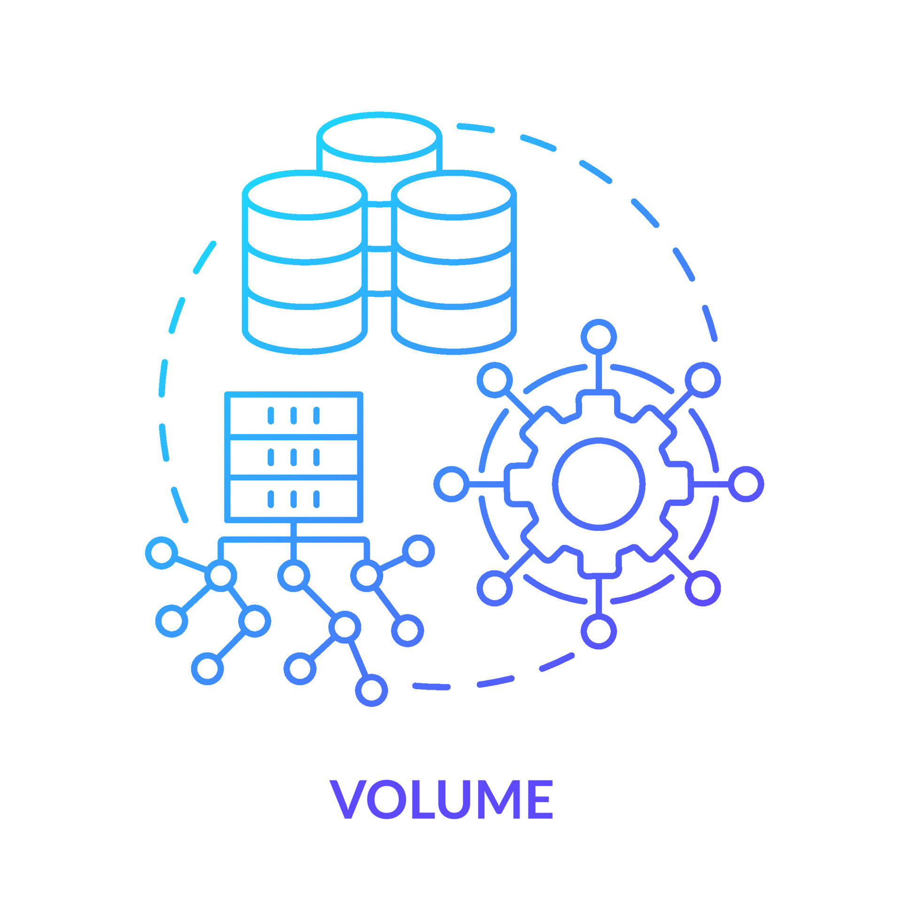
1) Volume
The name Big Data itself is related to an enormous size.
Big Data is a vast ‘volume’ of data generated from many sources daily, such as business processes, machines, social media platforms, networks, human interactions, and many more.

Slide 28

2) Variety
Big Data can be structured, unstructured, and semi-structured that are being collected from different sources.
Data will only be collected from databases and sheets in the past, but these days the data will comes in array forms, that are PDFs, Emails, audios, SM posts, photos, videos, etc.

Slide 29

3) Veracity
Veracity means how much the data is reliable.
It has many ways to filter or translate the data.
Veracity is the process of being able to handle and manage data efficiently.
Big Data is also essential in business development.

Slide 30

4) Value
Value is an essential characteristic of big data.
It is not the data that we process or store.
It is valuable and reliable data that we store, process, and also analyse.

Slide 31

5) Velocity
Velocity plays an important role compared to others.
Velocity creates the speed by which the data is created in real-time.
It contains the linking of incoming data sets speeds, rate of change, and activity bursts.
The primary aspect of Big Data is to provide demanding data rapidly.
Big data velocity deals with the speed at the data flows from sources like application logs, business processes, networks, and social media sites, sensors, mobile devices, etc.

Slide 32
Thank you!

